Slide 1
Map Reduce: Simplified Processing on Large Clusters
Jeffrey Dean and Sanjay Ghemawat
Google, Inc.
OSDI ’04: 6th Symposium on Operating Systems Design and Implementation

Slide 2
What Is It?
“. . . A programming model and an associated implementation for processing and generating large data sets.”
Google version runs on a typical Google cluster: large number of commodity machines, switched Ethernet, inexpensive disks attached directly to each machine in the cluster.

Slide 3
Motivation
Data-intensive applications
Huge amounts of data, fairly simple processing requirements, but …
For efficiency, parallelize
MapReduce is designed to simplify parallelization and distribution so programmers don’t have to worry about details.

Slide 4
Advantages of Parallel Programming
Improves performance and efficiency.
Divide processing into several parts which can be executed concurrently.
Each part can run simultaneously on different CPUs on a single machine, or they can be CPUs in a set of computers connected via a network.

Slide 5
Programming Model
The model is “inspired by” Lisp primitives map and reduce.
map applies the same operation to several different data items; e.g.,
(mapcar #'abs '(3 -4 2 -5))=>(3 4 2 5)
reduce applies a single operation to a set of values to get a result; e.g.,
(+ 3 4 2 5) => 14

Slide 6
Programming Model
MapReduce was developed by Google to process large amounts of raw data, for example, crawled documents or web request logs.
There is so much data it must be distributed across thousands of machines in order to be processed in a reasonable time.

Slide 7
Programming Model
Input & Output: a set of key/value pairs
The programmer supplies two functions:
map (in_key, in_val) => list(intermediate_key,intermed_val)
reduce (intermediate_key,
list-of(intermediate_val)) => list(out_val)
The program takes a set of input key/value pairs and merges all the intermediate values for a given key into a smaller set of final values.

Slide 8
Example: Count occurrences of words in a set of files
Map function: for each word in each file, count occurrences
Input_key: file name; Input_value: file contents
Intermediate results: for each file, a list of words and frequency counts
  out_key = a word; int_value = word count in this file
Reduce function: for each word, sum its occurrences over all files
Input key: a word; Input value: a list of counts
Final results: A list of words, and the number of occurrences of each word in all the files.

Slide 9
Other Examples
Distributed Grep: find all occurrences of a pattern supplied by the programmer
  Input: the pattern and set of files
    key = pattern (regexp), data = a file name
  Map function: grep the pattern, file
  Intermediate results: lines in which the pattern appeared, keyed to files
    key = file name, data = line
  Reduce function is the identity function: passes on the intermediate results

Slide 10
Other Examples
Count URL Access Frequency
  Map function: counts URL requests in a log of requests
    key: URL; data: a log
  Intermediate results: URL, total count for this log
  Reduce function: combines URL count for all logs and emits (URL, total_count)

Slide 11
Implementation
More than one way to implement MapReduce, depending on environment
Google chooses to use the same environment that it uses for the GFS: large (~1000 machines) clusters of PCs with attached disks, based on 100 megabit/sec or 1 gigabit/sec Ethernet.
Batch environment: user submits job to a scheduler (Master)

Slide 12
Implementation
Job scheduling:
  User submits job to scheduler (one program consists of many tasks)
  scheduler assigns tasks to machines.

Slide 13
General Approach
The MASTER:
  initializes the problem; divides it up among a set of workers
  sends each worker a portion of the data
  receives the results from each worker
The WORKER:
  receives data from the master
  performs processing on its part of the data
  returns results to master

Slide 14
Overview
The Map invocations are distributed across multiple machines by automatically partitioning the input data into a set of M splits or shards.
The worker-process parses the input to identify the key/value pairs and passes them to the Map function (defined by the programmer).

Slide 15
Overview
The input shards can be processed in parallel on different machines.
  It’s essential that the Map function be able to operate independently – what happens on one machine doesn’t depend on what happens on any other machine.
Intermediate results are stored on local disks, partitioned into R regions as determined by the user’s partitioning function. (R <= # of output keys)

Slide 16
Overview
The number of partitions (R) and the partitioning function are specified by the user.
Map workers notify Master of the location of the intermediate key-value pairs; the master forwards the addresses to the reduce workers.
Reduce workers use RPC to read the data remotely from the map workers and then process it.
Each reduction takes all the values associated with a single key and reduces it to one or more results.

Slide 17
Example
In the word-count app, a worker emits a list of word-frequency pairs; e.g. (a, 100), (an, 25), (ant, 1), …
out_key = a word; value = word count for some file
All the results for a given out_key are passed to a reduce worker for the next processing phase.

Slide 18
Overview
Final results are appended to an output file that is part of the global file system.
When all map/reduce jobs are done, the master wakes up the user program and the MapReduce call returns control to the user program.

Slide 19
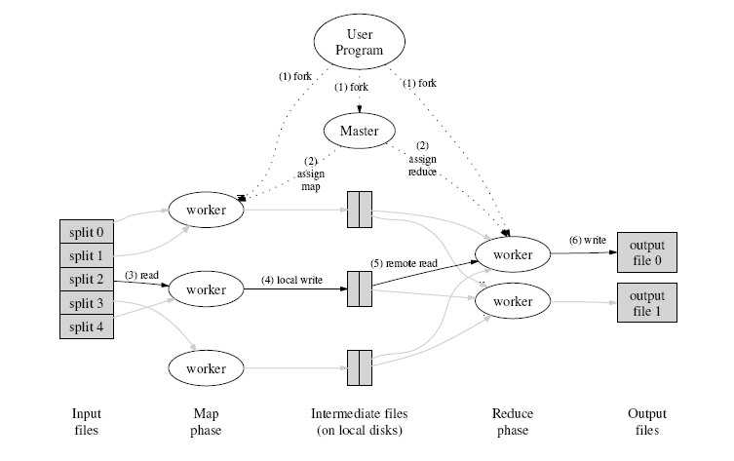

Slide 20
Fault Tolerance
Important, because since MapReduce relies on 100’s, even 1000’s of machines, failures are inevitable.
Periodically, the master pings workers.
Workers that don’t respond in a pre-determined amount of time are considered to have failed.
Any map task or reduce task in progress on a failed worker is reset to idle and becomes eligible for rescheduling.

Slide 21
Fault Tolerance
Any map tasks completed by the worker are reset to idle state, and are eligible for scheduling on other workers.
Reason: since the results are stored on the disk of the failed machine, they are inaccessible.
Completed reduce tasks on failed machines don’t need to be redone because output goes to a global file system.

Slide 22
Failure of the Master
Regular checkpoints of all the Master’s data structures would make it possible to roll back to a known state and start again.
However, since there is only one master failure is highly unlikely, so the current approach is just to abort the program in case of failure.

Slide 23
Locality
Recall Google File system implementation:
Files are divided into 64MB blocks and replicated on at least 3 machines.
The Master knows the location of data and tries to schedule map operations on machines that have the necessary input. Or, if that’s not possible, schedule on a nearby machine to reduce network traffic.

Slide 24
Task Granularity
Map phase is subdivided into M pieces and the reduce phase into R pieces.
Objective: M and R >> than the number of worker machines.
  Improves dynamic load balancing
  Speeds up recovery in case of failure; failed machine’s many completed map tasks can be spread out across all other workers.

Slide 25
Task Granularity
Practical limits on size of M and R:
  Master must make O(M + R) scheduling decisions and store O(M * R) states
  Users typically restrict size of R, because the output of each reduce worker goes to a different output file
  Authors say they “often” set M = 200,000 and R = 5,000. Number of workers = 2,000.

Slide 26
“Stragglers”
A machine that takes a long time to finish its last few map or reduce tasks.
  Causes: bad disk (slows read ops), other tasks are scheduled on the same machine, etc.
  Solution: assign stragglers’ unfinished work to other machines that have completed. Use results from the original worker or the backup, depending on which finishes first

Slide 27
Experience
Google used MapReduce to rewrite the indexing system that constructs the Google search engine data structures.
Input: GFS documents retrieved by the web crawlers – about 20 terabytes of data.
Benefits
  Simpler, smaller, more readable indexing code
  Many problems, such as machine failures, are dealt with automatically by the MapReduce library.

Slide 28
Conclusions
Easy to use. Programmers are shielded from the problems of parallel processing and distributed systems.
Can be used for many classes of problems, including generating data for the search engine, for sorting, for data mining, for machine learning, and other
Scales to clusters consisting of 1000’s of machines

Slide 29
But ….
Not everyone agrees that MapReduce is wonderful!
The database community believes parallel database systems are a better solution.

